Slide 1


A 4-day training programme on participatory practice for specialist sexual violence service providers
Day 3
Life skills, leadership, limitless potential (LEAP): Supporting children and young people affected by sexual violence in Europe by strengthening and facilitating participatory practice
Abi Billinghurst & Kate D’arcy

Slide 2
Group circle
What have we done so far?
What have we learnt?
Thoughts and reflections

Slide 3
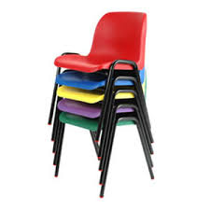
Notes:
Exercise: chairs
See LEAP day 3 session plans

Slide 4
Power
We must recognise the importance of the “imbalance of power that exists in the experience of receiving services, and the need to restore that balance through professional practice that is respectful, knowledgeable an patient.”
Brodie, I (2016)
Notes:
Exercise: low hanging fruit
Themes to consider when preparing for participation work

Slide 5
Three faces of power
Visible power: formal and observable decision-making, pluralist politics with visible ‘power over’ and clear winners and losers.
Hidden power: setting the agenda behind the scenes, mobilising biases and interests, excluding people an discussions from debates.
Invisible power: shaping public opinion and needs; social conditioning, ideology and values; may be internalised.
Jethro Petit
Notes:
Exercise: low hanging fruit
Themes to consider when preparing for participation work

Slide 6
Upper and lowers
Upper | Lower | Visible, invisible, hidden | Behaviour/use of power & impact of Upper | How are rights violated/ participation limited | What behaviour could change?
Teacher | Pupil | Visible | Intimidating, one way learning, | Access to education | Open ended discussions, consideration of different learning styles
Notes:
Exercise: low hanging fruit
Themes to consider when preparing for participation work

Slide 7
Realms of power
Public:
visible, employment,
public life,
relationships
(local/ community v’s
national)
Private:
family,
relationships,
friends, marriage
Jethro Pettit
Intimate:
self-esteem,
self-confidence,
relationship to body,
sense of physical and emotional autonomy in
relation to others.
Notes:
Public: visible, employment, public life, relationships (local v’s national)
Private: family, relationships, friends, marriage
Intimate: self-esteem, self-confidence, relationship to body, sense of physical and emotional autonomy in relation to others.
Jethro Pettit
Themes to consider when preparing for participation work

Slide 8

Doing participation
Low Hanging Fruit
Creating a safe space;
Group work with high risk young people;
Embedding participatory practice in organisational culture;
Accessibility for, and representation of, young people.
Notes:
Exercise: low hanging fruit
See LEAP day 3 session plans

Slide 9
Planning for participation
Emotional and welfare support for young people;
Safeguarding and risk management/mitigation;
On-going and informed consent;
Dealing with disclosure;
Representation of young people and preparing young people for public facing work;
Managing relationships with between the project and external partners and professionals;
Leadership ‘buy in’ within organisation;
Assessing harm v’s benefits for involvement in group work;
Working with the media;
Setting outcomes and project remit. Who? How?
Creating safe and accessible spaces;
Equal participation and non-discrimination;
Barriers and challenges young people face in accessing opportunity.
Notes:
Exercise: low hanging fruit
Themes to consider when preparing for participation work

Slide 10

Representation of young people
In groups create your group ‘identity’ shield.
Respond to the following questions in each
quarter of the shield:
Why did I take part in the training?
What are my strengths - what I brought to the training
What’s special about me (that I want others to know)?
Who do I speak up for/represent?
Source: Camille Warrington

Slide 11
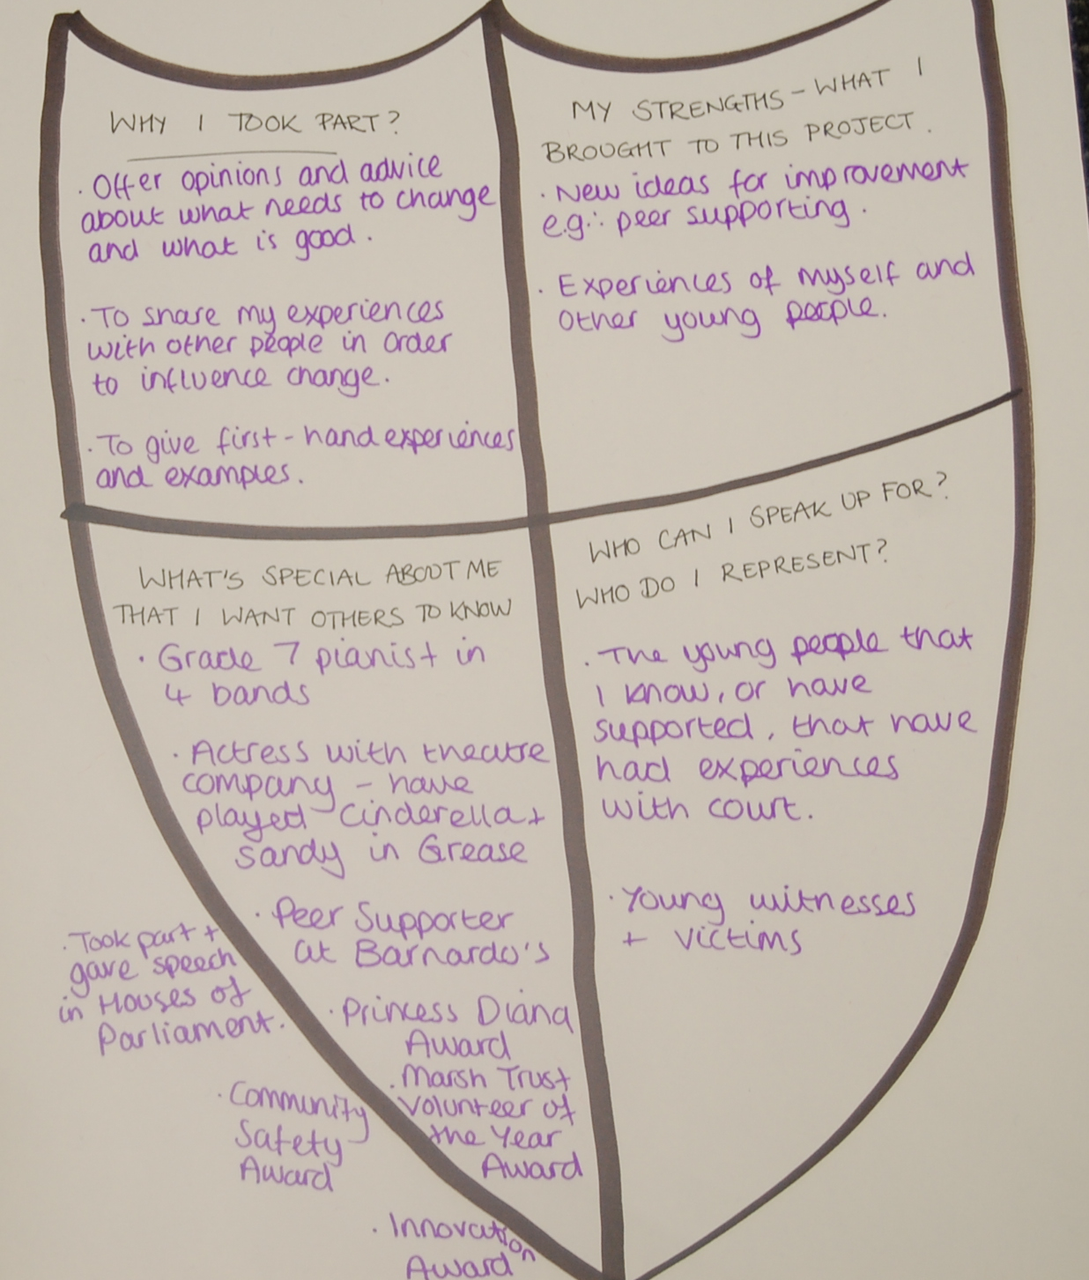
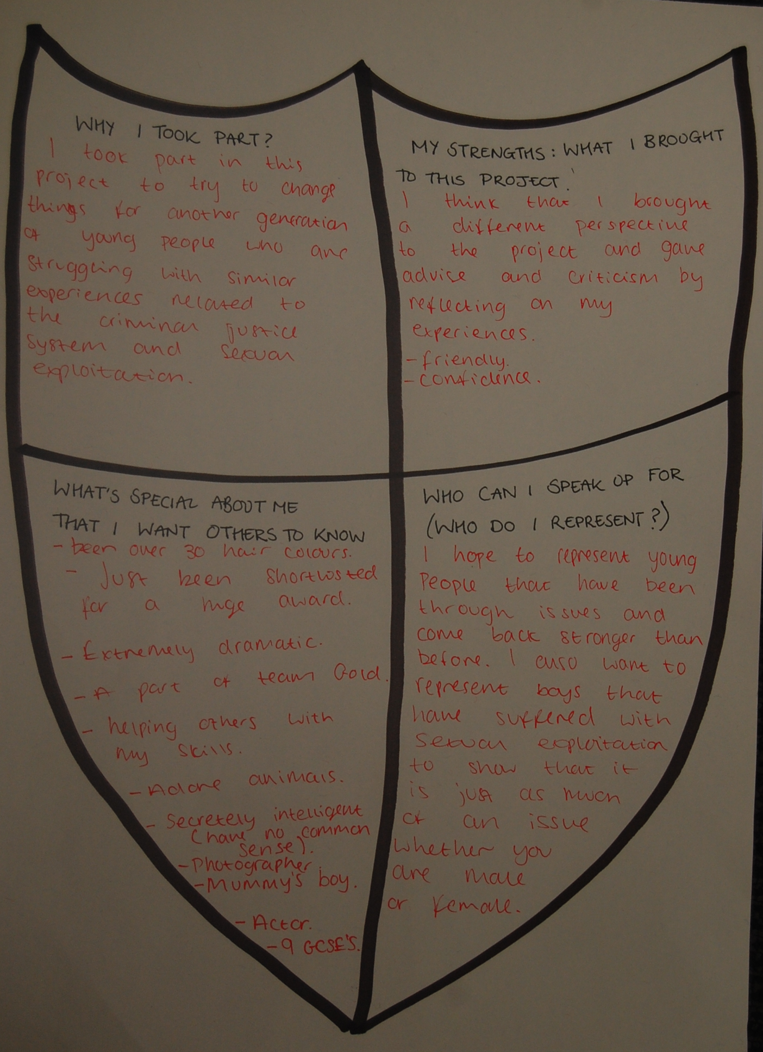

Slide 12
Representation of young people
In pairs (A & B). ‘A’ spend 1 minute telling ‘B’, how they got to the training today.
B must actively listen.
Swap
Join with another pair. Take it in turns for each person to tell their partners story in 1 minute.
Stand behind you seated partner while you tell their story.
Source: photovoice

Slide 13
Scaling
Think about your best hopes that you defined at the beginning of the day.
On a scale of 0 – 10, where ‘0’ is the worst things have ever been and ‘10’ is your best hopes, where are you today?
Add your response to the wall chart.

Slide 14
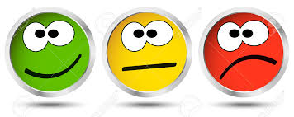
Mood metre

