Slide 1


A 4-day training programme on participatory practice for specialist sexual violence service providers
Day 1
Life skills, leadership, limitless potential (LEAP):
Supporting children and young people affected by sexual violence in Europe by strengthening and facilitating participatory practice
Abi Billinghurst & Kate D’arcy
Notes:
Welcome & introduction (20 mins)
Introduce the training programme briefly (check delegates are in the right training!) explaining that we will give a full overview of the entire EC project shortly.
Introduce the trainers briefly
Explain that this is the pilot of this training which is being run in order to gather feedback to inform development of the programme
HousekeepingExplain emergency evacuation process, location of toilets/accessible toilets, other accessibility resources
Registration
Ask all delegates to sign in using the attendance sheet
Ask all delegates to complete the pre-evaluation questionnaire. Explain that they will be asked the same questions at the end of the training in order that we can gather pre- and post-data as to the impact of the training.
Handout the End Feedback Form and explain that they are required to complete this form at the end of the training in order that we can develop the training based on their feedback. This is ESSENTIAL and a condition of their free attendance on the programme. They may find it useful to complete these as the course progresses.
Media consent forms: explain that some of the training will be filmed as the next phase of the project in order to create e-learning resources and podcasts/webinars. Delegates should complete and sign forms prior to training

Slide 2

https://www.google.co.uk/imgres?imgurl=http%3A%2F%2Fwww.freelargeimages.com%2Fwp-content%2Fuploads%2F2014%2F12%2FA_b_c-4.png&imgrefurl=http%3A%2F%2Fwww.freelargeimages.com%2Fa-b-c-2006%2F&docid=XVjP_zenRBngGM&tbnid=ufae8FogqBPUNM%3A&w=1024&h=768&ved=0ahUKEwiU6vbo3fzLAhWHPRoKHcKNCugQMwg4KAYwBg&iact=mrc&uact=8
Notes:
Icebreaker (10 mins)
Alphabet game: see training Day 1 plan

Slide 3
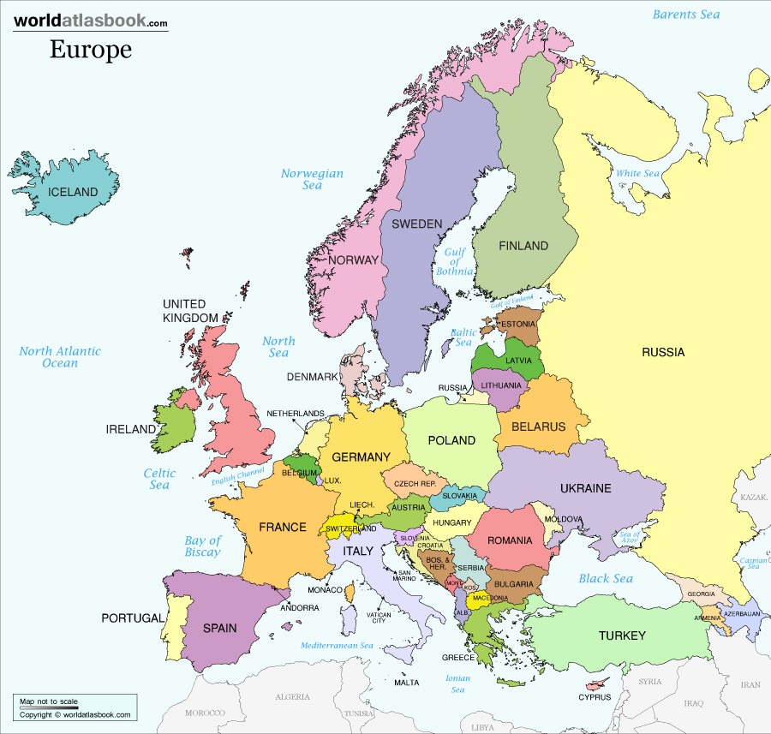
LEAP Project Mapping
http://www.worldatlasbook.com/images/maps/europe-map-political-countries.jpg
Notes:
Exercise: LEAP Project Mapping (15 mins)
See Day 1 training plan

Slide 4
Training aims
Improve knowledge, skills and understanding of a child-rights, safe and ethical participatory practice;
Develop confidence, and a commitment to, participatory practice when supporting children and young people (CYP) who are affected by sexual violence (SV);
Address the challenges and barriers of implementing participatory practice;
Support practitioners to become ‘champions’ in advocating for the participation of CYP affected by SV;
Develop the skills of practitioners to assess and develop action plans and policy to improve and embed participatory practice in specialist sexual violence provision for CYP.
Notes:
Explain the objectives of the training
Set the tone of the training: See Day 1 Training Plan for notes

Slide 5
Individual outcome setting
What are your best hopes from our work together on the 4-day LEAP training?
Name two things that you would be pleased to see yourself doing differently, that would tell you that you have achieved your best hopes.
On a scale of 0 – 10, where ‘0’ is the worst things have ever been and ‘10’ is your best hopes, where are you today?
Notes:
Exercise: Individual outcome setting (15 mins)
See Day 1 training plan

Slide 6
Group Agreement
Young people to decide what is needed to create a safe and respectful space;
Practitioners and young people ‘sign-up’ to the agreement and agree on expectations of each other and the process;
Sets foundation for young people to ‘police’ themselves and set sanctions (if desired);
Sets tone for joint decision making and disrupts traditional power hierarchy in decision making.
Notes:
Exercise: Group agreement (30 mins)
See Day 1 training plan

Slide 7

https://www.google.co.uk/imgres?imgurl=http%3A%2F%2Fwww.workswithwater.com%2Fblog%2Fwp-content%2Fuploads%2F2012%2F09%2Ftoothpaste-new.jpg&imgrefurl=http%3A%2F%2Fwww.workswithwater.com%2Fblog%2Fdoes-toothpaste-work-on-spots%2F&docid=DLKw0EVQLv_WzM&tbnid=qA3Fe_ELgi4fUM%3A&w=625&h=380&ved=0ahUKEwjaneaKyP3LAhUFKywKHc1kBo4QMwhwKDQwNA&iact=mrc&uact=8
Notes:
Exercise: toothpaste exercise
See Day 1 training plan

Slide 8

https://www.google.co.uk/imgres?imgurl=http%3A%2F%2Fbrfm.net%2Fwp-content%2Fuploads%2F2015%2F10%2FTraffic-Lights.jpg&imgrefurl=http%3A%2F%2Fbrfm.net%2Ftraffic-lights-barton-hill-road-junction-of-lower-road%2F&docid=vcNNDmuY6b9z6M&tbnid=DWs2o1rR_BycBM%3A&w=819&h=1024&ved=0ahUKEwiuvaLc1v7LAhWHuBQKHQJoAEMQMwg5KAcwBw&iact=mrc&uact=8
Notes:
Exercise: Continuum exercise
See Day 1 training plan

Slide 9
Child sexual abuse
“Child sexual abuse is the involvement of a child in sexual activity that he or she does not fully comprehend, is unable to give informed consent to, or for which the child is not developmentally prepared and cannot give consent, or that violates the laws or social taboos of society. Child sexual abuse is evidenced by this activity between a child and an adult or another child who by age or development is in a relationship of responsibility, trust or power, the activity being intended to gratify or satisfy the needs of the other person. This may include but is not limited to:
the inducement or coercion of a child to engage in any unlawful sexual activity;
the exploitative use of a child in prostitution or other unlawful sexual practices;
the exploitative use of children in pornographic performance and materials”.
World Health Organisation, 1999

Slide 10
Child sexual exploitation
“Sexual exploitation of children and young people under 18 involves exploitative situations, contexts and relationships where young people (or a third person or persons) receive 'something' (e.g. food, accommodation, drugs, alcohol, cigarettes, affection, gifts, money) as a result of them performing, and/or another or others performing on them, sexual activities. Child sexual exploitation can occur through the use of technology without the child's immediate recognition; for example being persuaded to post sexual images on the Internet/mobile phones without immediate payment or gain. In all cases, those exploiting the child/young person have power over them by virtue of their age, gender, intellect, physical strength and/or economic or other resources. Violence, coercion and intimidation are common, involvement in exploitative relationships being characterised in the main by the child or young person's limited availability of choice resulting from their social/economic and/or emotional vulnerability”.
DCSF, 2009

Slide 11
What is sexual violence?
“Any behaviour perceived to be of a sexual nature, which is unwanted or takes place without consent or understanding”
(Becket, H, 2013)
Notes:
Exercise: what is sexual violence?
See LEAP day 1 session plans

Slide 12
Common to CSA, CSE and SV
No/constrained choices;
Coercion and control;
Limited or lack of understanding;
Sexual in nature;
Power.

Slide 13
How are young people affected by sexual violence?
Mental health issues: PTSD, anxiety, depression; dissociation
Suicidal ideation, suicide, self harm;
Low self-esteem, withdrawal;
Feelings of guilt, shame, self-blame, grief, confusion;
Unmanageable feelings of anger;
Short and long-term physical and sexual health issues;
Impact on cognitive development, attachment, trust and relationship forming;
Heightened sexualised behavior and risk taking, problematic alcohol and substance use;
Ostracised from peers, school, family and community groups;
Rarely report and routinely disbelieved, seen as ‘trouble makers’;
Excluded from the decision making that effects them;
Not in control of decisions and processes around them (reflecting power dynamics of abuse);
Notes:
Doesn’t include the copious issues that are involved in the ‘legacy’ that is left in regard to criminal justice procedures, appropriate support etc.

Slide 14
What is participation?

Slide 15
Participation is everyone’s responsibility
“Young people at risk of experience or experiencing CSE are also in contact with other services, or will need to be supported in accessing other services… A participative approach that treats young people as individuals and provides a space for dialogue rather than judgment, should be the task of all agencies working with vulnerable children and young people.”
Brodie, I (2016)

Slide 16
What is participation?
“sharing decisions which affect one’s life and the life of the community in which one lives. It is the means by which a democracy is built and it is a standard against which democracies should be measured. Participation is the fundamental right of citizenship”.
Hart, R (1992)

Slide 17
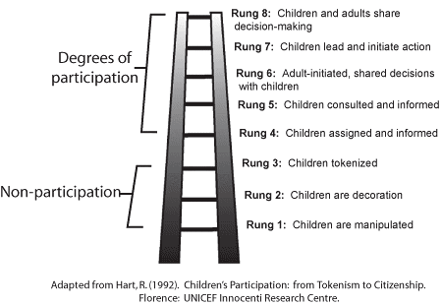
Hart’s ladder of participation

Slide 18
The principles of participation
Recognition and reversal of the usual power dynamics;
Reversal of reality;
Reversal of learning;
Belief in capabilities;
Hearing form the least powerful;
Handing over the stick;
Self-critical awareness;
Sharing: of information and ideas;
Learning and change is iterative: feedback check, reflecting;
Creating opportunities for self representation and young people TAKING power;
Recognising and combating oppression.
Adapted from ‘Putting the first last. Whose reality counts?’( Chambers, R, 1997)

Slide 19
Power,
Oppression,
and
The importance of a ‘critical consciousness’

Slide 20
Paulo Freir’s Critical Conciousness
Critical consciousness is the ability to perceive social, political, and economic oppression and to take action against the oppressive elements of society.

Slide 21
The principles of participation
In pairs, pick one participation principle from the ‘hat’. Discuss:
How have you applied this principle in practice?
or
How could this principle be applied in practice?
Think beyond ‘one off’ service user engagement events. Are you embedding this principle in practice?
Share examples of what you are doing well.

Slide 22
What are the benefits of participation?
Therapeutic benefits, reduces isolation;
Critical thinking;
Develop alternative narratives of their identity. From ‘victim’ or ‘difficult’ to ‘powerful’ and ‘competent’;
Forming relationships based on mutual respect and equality;
Challenging unhealthy power and hierarchy in relationships;
Creating safe spaces, where they can think through and discuss risk issues in a safe way;
Crating peer support where the ‘personal’ can become ‘political’
Creating the space where young people can ‘take’ power;
A different way of engaging with a group that are notoriously difficult to engage with;
Experiential, learning by doing;
Develop self efficacy, resilience, confidence, conflict resolution and communication skills;
Develop transferable skills to strategise for, and navigate risk;
Increases protective factors.

Slide 23
It’s more than citizenship!
Participation rights or protection rights?
Participation is protection – an intervention in its own right;
Without participation, abuse through sexual violence can flourish;
A failure to listen to CYP can have damaging consequences;
Participation of CYP leads to better decision making;
A method of survival and coping.

Slide 24
Scaling
Think about your best hopes that you defined at the beginning of the day.
On a scale of 0 – 10, where ‘0’ is the worst things have ever been and ‘10’ is your best hopes, where are you today?
Add your response to the wall chart.

Slide 25

Mood metre

