Slide 1


A 4-day training programme on participatory practice for specialist sexual violence service providers
Day 2
Life skills, leadership, limitless potential (LEAP):
Supporting children and young people affected by sexual violence in Europe by strengthening and facilitating participatory practice
SECOS Young People’s Group
Abi Billinghurst & Kate D’arcy

Slide 2
Group circle
What have we done so far?
What have we learnt?
Thoughts and reflections

Slide 3

Notes:
Human bingo ice breaker

Slide 4

Notes:
Power walk exercise

Slide 5
The United Nations Convention on the
Rights of the Child (UNCRC)
The Convention has 54 articles that cover all aspects of a child’s life and set out the civil, political, economic, social and cultural rights that all children everywhere are entitled to.
It also explains how adults and governments must work together to make sure all children can enjoy all their rights
In 1989, governments worldwide promised all children the same rights by adopting the UN Convention on the Rights of the Child, also known as the CRC or UNCRC.
The Convention changed the way children are viewed and treated – in other words, as human beings with a distinct set of rights instead of as passive objects of care and charity.
These rights describe what a child needs to survive, grow, and live up to their potential in the world.
They apply equally to every child, no matter who they are or where they come from.
All children have rights.
Source: SECOS Young People’s Participation Group

Slide 6
UNCRC, SV and participation
Article 3: All adults should do what is best for you. When adults make decisions, they should think about how their decisions will affect children;
Article 12: You have the right to give your opinion, and for adults to listen and take it seriously;
Article 13: You have the right to find out things and share what you think with others, by talking, drawing, writing or in any other way unless it harms or offends other people;
Article 34: You have the right to be free from sexual abuse;
Article 35: No one is allowed to kidnap or sell you;
Article 36: You have the right to protection from any kind of exploitation (being taken advantage of);
Article 42: You have the right to know your rights! Adults should know about these rights and help you learn about them, too.

Slide 7
Policy Context
All project partner countries have signed and ratified the UNCRC (apart from the UK who has not ratified it);
All partner countries have signed the Lanzarote Convention;
General recognition that the operational response to CYP experiences of CSA/CSE needs to be multi-disciplinary and the responsibility of all;
Frustrations across partner countries where law and policy does not support efforts at operational level to deliver UNCRC – or undermines UNCRC;
Age of consent and sexual offences vary across partner countries;
Different definitions and focus means abuse associated with CSE may not be identified (i.e CSA located in familial context and SV located in DV context).

Slide 8
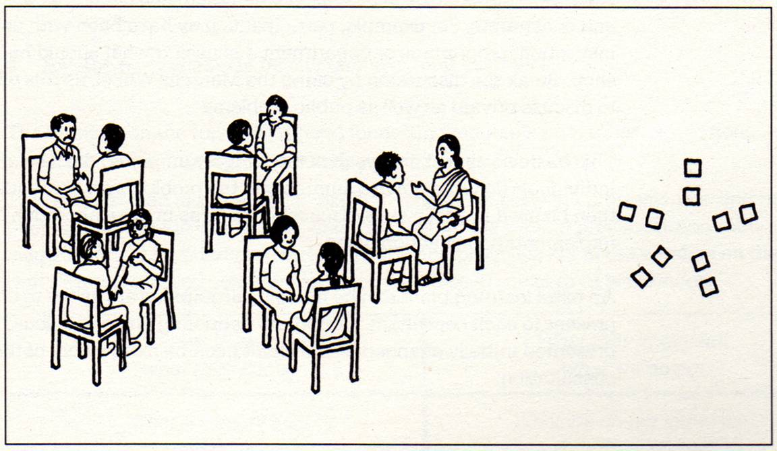
Barriers and challenges

Slide 9
What are the ethical implications of participatory practice?

Slide 10
Ethical practice
That no harm should come to any individual as a result of their agreement to facilitate or take part. Work with children and young people affected by sexual violence must be informed by an understanding of the:
impact of abuse, discrimination and trauma;
dynamics and related protective strategies when working in group settings;
issues regarding anonymity and potential stigma arising from project participation;
importance of managing children and young people’s realistic expectations and managing boundaries;
importance of ensuring children and young people’s consent to participate is both fully informed and reviewed;
The wellbeing of children and young people and staff will be a primary concern throughout.

Slide 11
Contextualised ethics mapping
Context | Young person
 | Family, friends & social relationships
 | Community, local area, region
 | Organisational, external and partners
 | Time

Slide 12
Ethical challenges
Risk of re-traumatising;
Stigma and identity;
Anonymity v’s acknowledgement;
Representation and identity;
Confidentiality and the danger of antagonising external risks;
Increasing risk by bringing vulnerable CYP together;
Transparency and expectation setting – agenda and influence;
CYP process v’s professional product;
Stakeholder and external pressure and control (ownership);
Too much responsibility?
Underestimating time and resource requirements;
Difficulty in monitoring impact and CYP’s power;
Using social media.

Slide 13
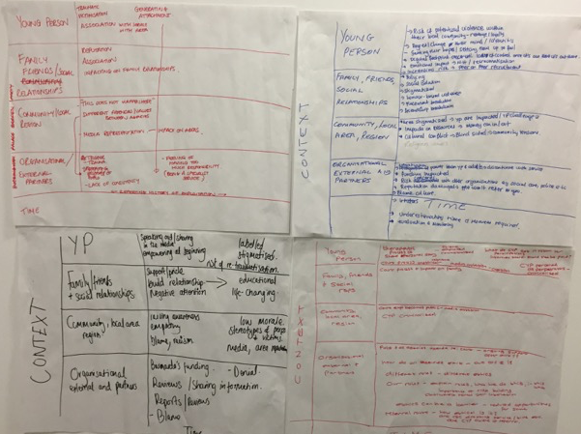
Contextualised ethics mapping

Slide 14

Notes:
End exercise: ball of string
See LEAP day 2 session plans

Slide 15
Scaling
Think about your best hopes that you defined at the beginning of the day.
On a scale of 0 – 10, where ‘0’ is the worst things have ever been and ‘10’ is your best hopes, where are you today?
Add your response to the wall chart.

Slide 16

Mood metre

